Slide 1
Maven Life Cycle & Goals
Maven is a popular open-source build tool developed by the Apache Group to build, publish, and deploy several projects at once for better project managemenT. The tool provides allows developers to build and document the lifecycle framework.

Slide 2
Maven Lifecycle
This is a query frequently posed in the field of software development. Maven is fundamentally structured around the concept of a build lifecycle.
The stages in Maven Life-cycle are:-
Validate
Compile
Test
Package
Integration Test
Verify
Install
Deploy

Slide 3
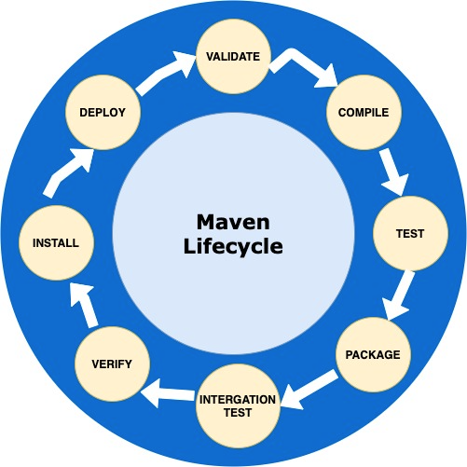
Maven lifecycle

Slide 4
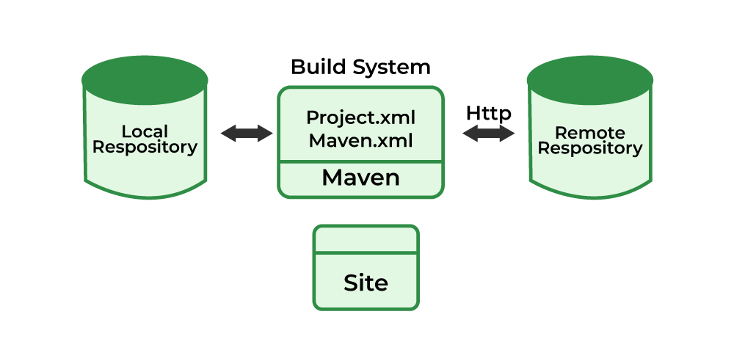
Goal
Maven's purpose is to provide developers with: A comprehensive, maintainable, reusable, and simple model for projects.
A set of tools and plug-ins that can interact with the declarative model.

Slide 5
Uses Of Maven
Maven can add all the dependencies required for the project automatically by reading pom file.
One can easily build their project to jar, war etc. as per their requirements using Maven.
Maven makes easy to start project in different environments and one doesn’t needs to handle the dependencies injection, builds, processing, etc.
Adding a new dependency is very easy. One has to just write the dependency code in pom file.
When there are a lot of dependencies for the project. Then it is easy to handle those dependencies using maven.

Slide 6
Advantages
Dependency Management :Maven simplifies the management of project dependencies. It automatically downloads and manages libraries and dependencies from remote repositories, reducing the manual effort required by developers.
Project Object Model (POM):Maven uses a declarative approach with the Project Object Model (POM), which is an XML file containing project configurations. This makes it easier to manage project settings and share project information among team members.
Centralized Repository:Maven Central Repository serves as a centralized repository for a vast collection of open-source libraries and artifacts. Developers can easily access and download dependencies from this repository.

Slide 7


